Slide 1
Trend Teknologi Informasi
Onno W. Purbo
onno@itb.ac.id
onno@indo.net.id

Slide 2
Akalan-Akalan Teknologi Informasi
Onno W. Purbo
onno@indo.net.id
onno@itb.ac.id

Slide 3
Focus ..
Realistis untuk Indonesia
Maksimumkan Teknologi
Akali .. Telkom, Indosat, ISP ..
  Bagaimana caranya kita lebih untung.

Slide 4
Referensi ..
Baca Majalah Infokomputer
Baca buku Elexmedia Komputindo
  “TCP/IP”
  “Teknologi Warung Internet”
Toko Buku Gramedia
risa@elexmedia.co.id

Slide 5
Hot Technology
WaveLAN 2Mbps s/d 11Mbps
WARNET
  Akses Web
  1 Perusahaan – 1 Domain – 1 Dial-up
Internet Telepon

Slide 6
Hot Aplikasi
E-Commerce
  Business-to-Customer
  Business-to-Business
Knowledge Management

Slide 7
Hot Technology

Slide 8
WaveLAN CDMA

Slide 9
WaveLAN CDMA
Spec:
  2Mbps
  5-10 km distance
  Builtin Router + Ethernet connector
URL:
  http://hydra.carleton.ca

Slide 10
Homebrew CDMA
Lucent CDMA 2Mbps-11Mbps
Router FreeBSD.
Homebrew antenna (cost ~US$150).
Max. distance 15km (use PA for more).
AI3 Indonesia MAN using this technology.

Slide 11
PC Card Price Comparison
Manufacturer | Mbps | Cost
Lucent WaveLAN | 1, 2 | US$495
Proxim RangeLAN | 1, 2 | US$595
Samsung SWL-1000 | 1, 2 | US$349
Aironet PC3500 | 1, 2 | US$495
BreezeCOM SA-PCR | 1, 2, 3 | US$565
Nortel BayStack 650 | 1 | US$499

Slide 12

WaveLAN 2.4GHz 11Mbps

Slide 13
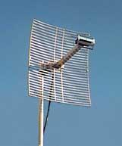
Antenna 2.4GHz 17dBi

Slide 14
In Building Wireless LAN

Slide 15
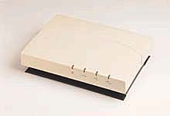
IEEE 802.11 Access Point

Slide 16
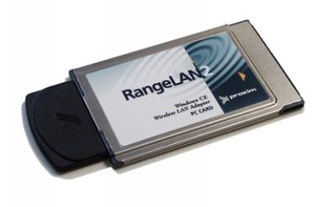
Proxim RangeLAN 1.5Mbps

Slide 17
Access Point Comparisons
Manufacturer | Mbps | Cost
Aironet SP4500 | 1, 2 | US$1595
BreezeCOM | 1, 2 | US$1495
Lucent WavePoint | 1, 2 | US$1885
Proxim 8521 | 1, 2 | US$1895
Nortel BayStack 660 | 1, 2 | US$1799

Slide 18
Teknologi WARNET
Akses Web
  Wingate – accounting usage
E-mail untuk User
  Banyak e-mail – 1 domain – 1 dial-up

Slide 19
Sepintas Bisnis Plan
Investasi
Operating Cost (Monthly)
Estimated Income

Slide 20
Overview Bisnis (x juta)
Bisnis | Invest | Cost | Income | RoI
E-mail 300 usr | 21 | 1.2 | 3 | 13
Web 10 PC | 50 | 3 | 5.5 | 18
Web 3 PC | 20 | 2.2 | 2.6 | ?

Slide 21
Akses Web

Slide 22
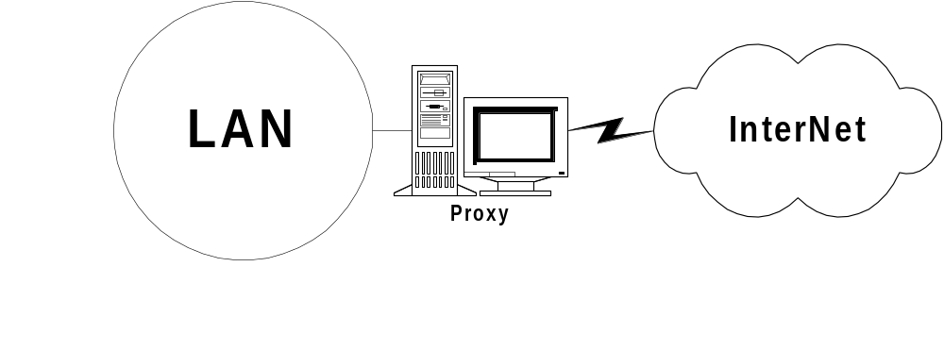
Akses Web
Windows95 + Wingate

Slide 23
Akses Web
Gateway PC
Windows95
Wingate
http://www.shareware.com
http://www.download.com

Slide 24
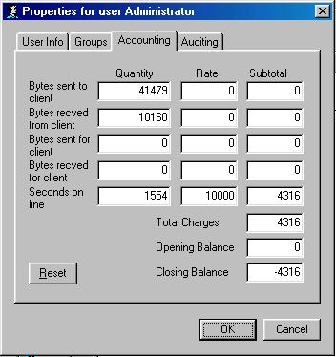
Accounting Time

Slide 25
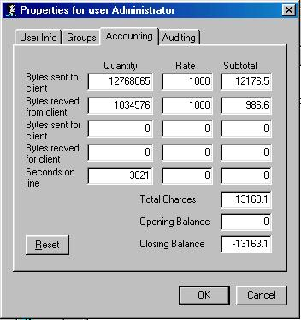
Accounting Byte

Slide 26
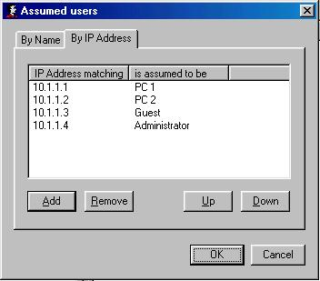
Mapping User

Slide 27
Konsekuensi Akses Web
Akses Web adalah komoditi mahal.
Sekitar Rp. 10.000 / jam.

Slide 28
Akses E-mail ..

Slide 29
Akses E-mail
Menggunakan FreeWeb Mail
  mail.yahoo.com
  mailcity.com
  usa.net
Menggunakan Warung Internet
Cara MAHAL untuk akses E-mail! (sekitar Rp. 500-1000 / e-mail)

Slide 30
Akses E-mail
Semua dapat E-mail
Satu domain
Satu account ISP
  Langganan perorangan

Slide 31
Akses E-mail
Account dari ISP (umumnya 1 e-mail)
Share bersama account dari ISP.
Membeli beberapa account e-mail dari ISP
Mengakali satu account dengan banyak Full Name

Slide 32
Bagaimana kalau?
Satu account ke ISP ..
Mempunyai domain sendiri
  unair.ac-id.net
  smun1.ac-id.net
  smpn2-bandung.ac-id.net
  dipanegara.ac-id.net
Banyak E-mail addres dengan format
  user@host.ac-id.net

Slide 33
Bagaimana kalau?
TANPA account di ISP ..
Mempunyai domain sendiri
  unair.ac-id.net
  smun1.ac-id.net
  smpn2-bandung.ac-id.net
  dipanegara.ac-id.net
Banyak E-mail addres dengan format
  user@host.ac-id.net

Slide 34
Bagaimana kalau?
Rp. 150 / menit
Cukup 5-10 menit / hari?
Cukup Rp. 50-200.000 / bulan?
+ biaya service ETRN / DomainPOP

Slide 35
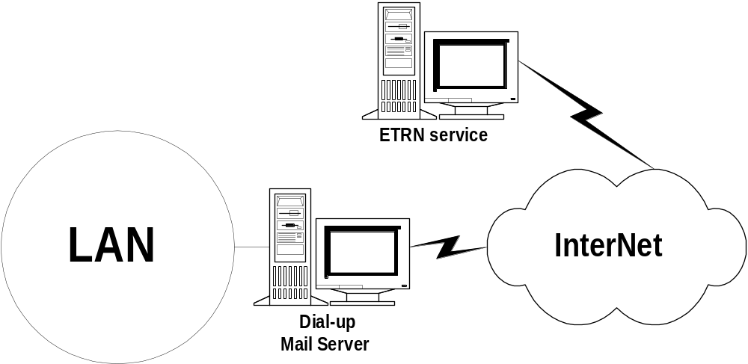
Akses E-mail
Windows95 + MDaemon

Slide 36
Dua Alternatif
Servis ETRN
Servis DomainPOP

Slide 37
Akses E-mail
Mdaemon
  http://www.altn.com
  http://www.mdaemon.com
Gunakan command ETRN
Cari servis ETRN
  etrn.com
  etrn-host.itb.ac.id

Slide 38
Akses E-mail
Mdaemon
  http://www.altn.com
  http://www.mdaemon.com
Gunakan command DomainPOP
Cari servis DomainPOP
  etrn-host.itb.ac.id

Slide 39
Skenario DomainPOP

Slide 40
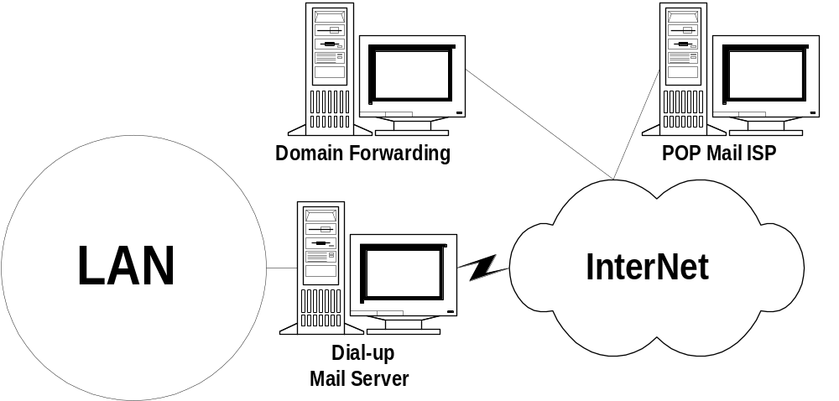
Player di Mail Servis
Tempat Forwarding E-mail
POP Mail Server di ISP
User Workstation di LAN
Mail Server
Ambil dari POPMail

Slide 41
Setup / Persiapan E-mail
Operator Setup
Domain Forwarding
Domain Forward
1 e-mail addres
Registrasi Domain
MX ke host Forwarding

Slide 42
Mail Server Dial Internet
Request
DomainPOP
mail
Dial ke ISP
Kirim Mail ke
Server Internet

Slide 43
POPMail Server kirim mail
POPMail
Kirim mail

Slide 44
User Mengambil Mail
User LAN
Ambil Mail POP3 ke
Mail Server Lokal

Slide 45
User Mengambil Mail
E-mail Software
MS Outlook Express
Eudora
Web / Internet Explorer

Slide 46
Internet Telephone

Slide 47
Referensi
http://www.quicknet.net
http://openphone.org
http://www.pulver.com

Slide 48
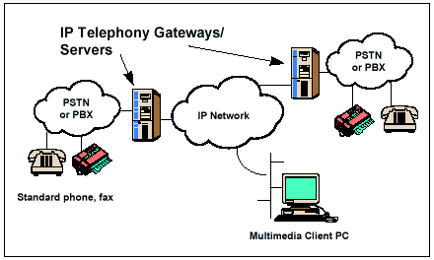
Internet Telephone

Slide 49
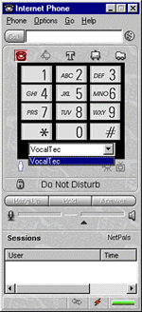
Dialer

Slide 50
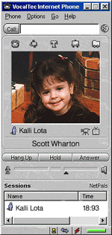
Video Conference

Slide 51
Komponen VoIP / Menit
Telkom Rp. 75 / menit
ISP Rp. 75 / menit
Hook-off Service
  http://www.net2phone.com

Slide 52
Comparison SLI / Menit
Country | Peak | Normal | Disc | VoIP
US | 9900 | 8300 | 6230 | 1350
Singapore | 6780 | 5650 | 4240 | 2550
Taiwan | 9960 | 8300 | 6270 | 4070
Jepang | 11286 | 9400 | 7050 | 2310
Hong Kong | 9960 | 8300 | 6230 | 2710

Slide 53
Solusi Kantor Kecil / Rumah
Satu (1) Saluran VoIP
Internet PhoneJACK US$150
Internet LineJACK US$220
Internet PhoneCARD US$170

Slide 54
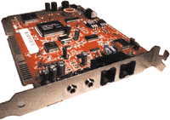
Internet PhoneJACK

Slide 55
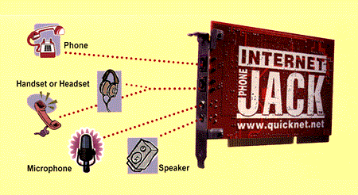
Connection PhoneJACK

Slide 56

Internet PhoneCARD

Slide 57
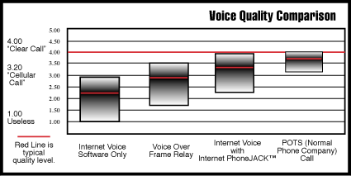
Voice Quality Comparison

Slide 58
Solusi Gateway Sederhana

Slide 59
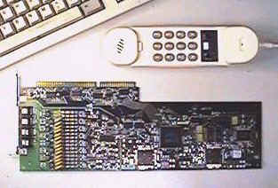
VoiceTronix (8 port)

Slide 60
VoIP untuk WARNET
Investasi WARNET+
Invest Card DSP ~US$150 / kanal.
Estimasi ke US biaya / menit
  US$0.13 + Rp. 75 + Rp. 75
Estimasi ke US biaya SLI 001
  Rp. 8300 / menit

Slide 61
Issue Desktop
Ease of Installation.
Infrastructure.
Flexibility.
Compatibility.
Ease-of-Use.
Quality.
Cost
Growth Path.
Base for Applications.

Slide 62
Aplikasi Desktop VoIP
IntraNet Communication
Remote Call Forwarding
Distributed Call Center
Virtual PBX
Line Doubling
Personal Iphone Calling

Slide 63
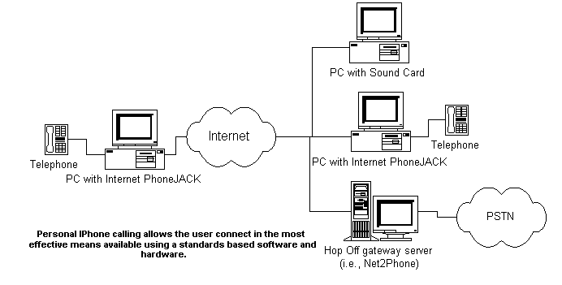
Personal Iphone Calling

Slide 64
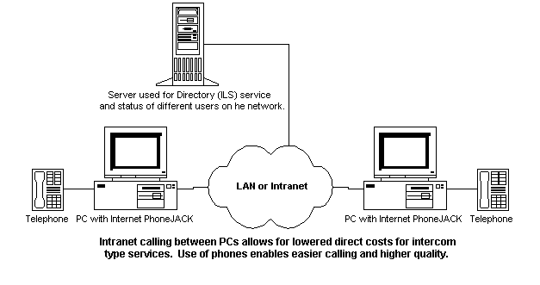
Intranet Communications

Slide 65
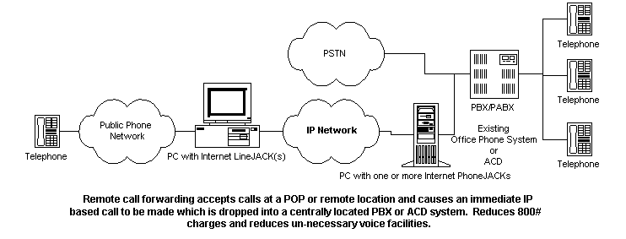
Remote Call Forwarding

Slide 66
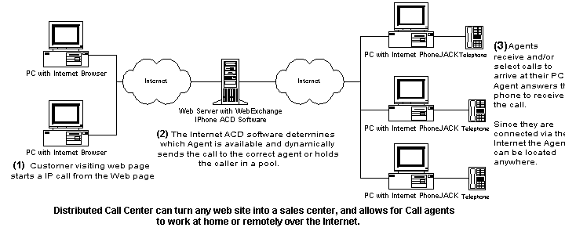
Distributed Call Center

Slide 67
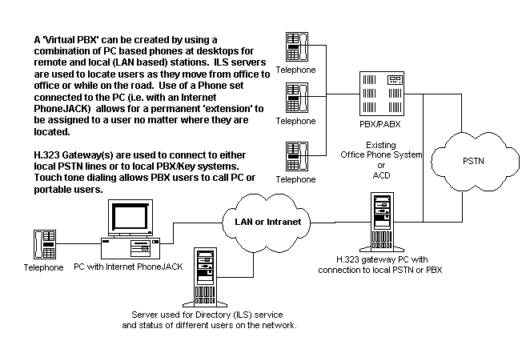
Virtual PBX

Slide 68
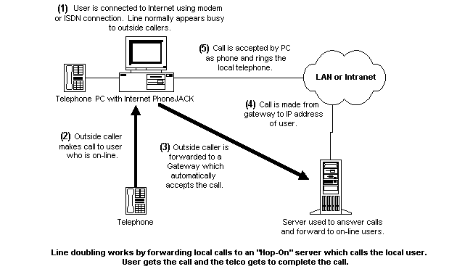
Line Doubling

Slide 69
Hot Aplikasi
e-Commerce
Knowledge Management

Slide 70
e-Dagang

Slide 71
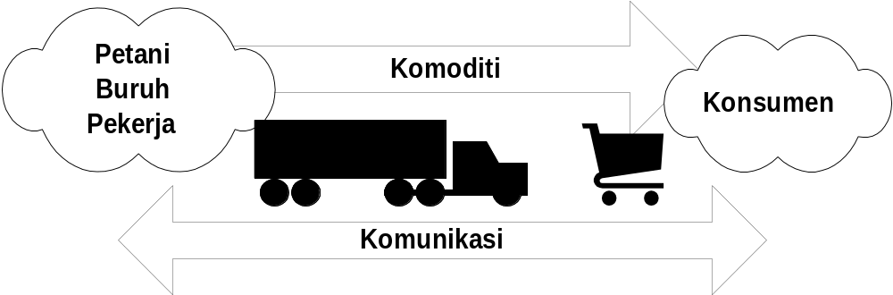
Model Rantai Dagang

Slide 72
Intisari e-Dagang ..
Transaksi = komunikasi.
Kepercayaan (trust)

Slide 73
Solusi e-Dagang
Bisnis-to-bisnis
  dominan
Bisnis-to-customer
  minoritas

Slide 74
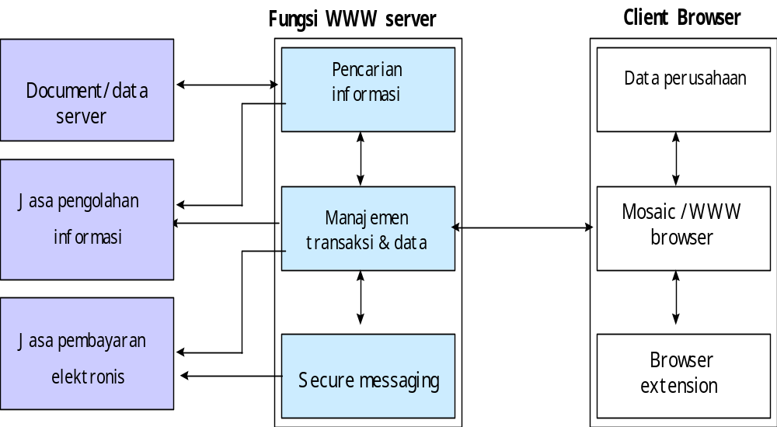
Ars. Business - Customer

Slide 75
Solusi e-Dagang sederhana
Cukup menggunakan e-mail
Bisa menggunakan WARNET!
Mailing list / e-mail
  wong-cilik@isnet.itb.ac.id

Slide 76
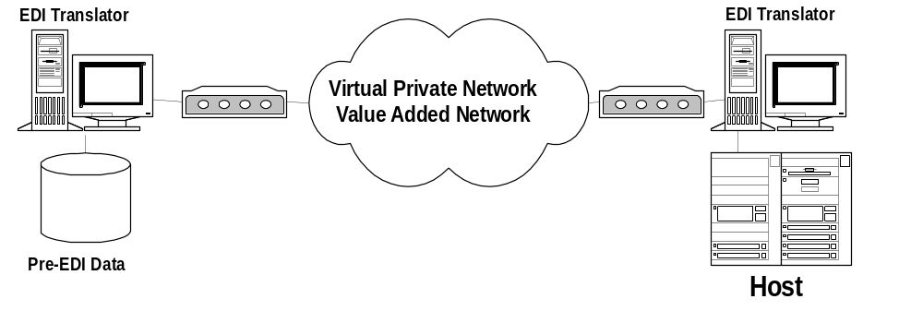
Ars. Business - Business

Slide 77
Electronic Data Interchange (EDI)
Interaksi text based melalui jaringan.
Transaksi standard dengan berbagai instansi:
  Custom.
  Bank.
  Travel.
  Pajak.
Kunci adalah database & software EDI translator.

Slide 78
To Whom EDI Can Be Used?
Banking / fund transfer / credit / debit transactions
Custom; Legal action
Airline / ticketing; Shipping / cargo
Tender / contract; Purchase order; Invoice
Job order
Medical Service
Tax; Reinsurance

Slide 79
Major cost to move to EDI
Purchase EDI software.
Contract with a VAN service provider (or Internet).
Do the data analysis needed to map information from their application systems into the EDI standard format.
Do the programming required to create a file that can interface with EDI translation software.

Slide 80
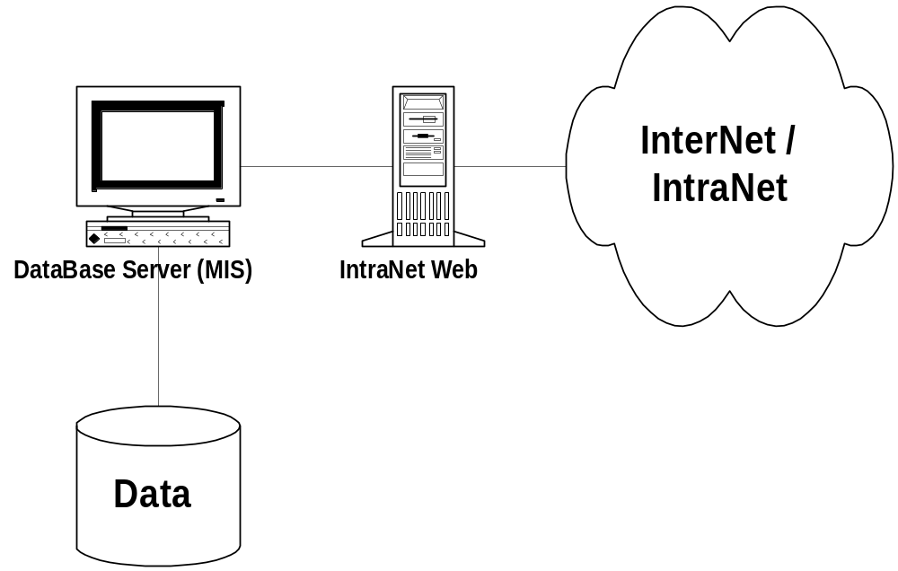
Database dibalik Web Server

Slide 81
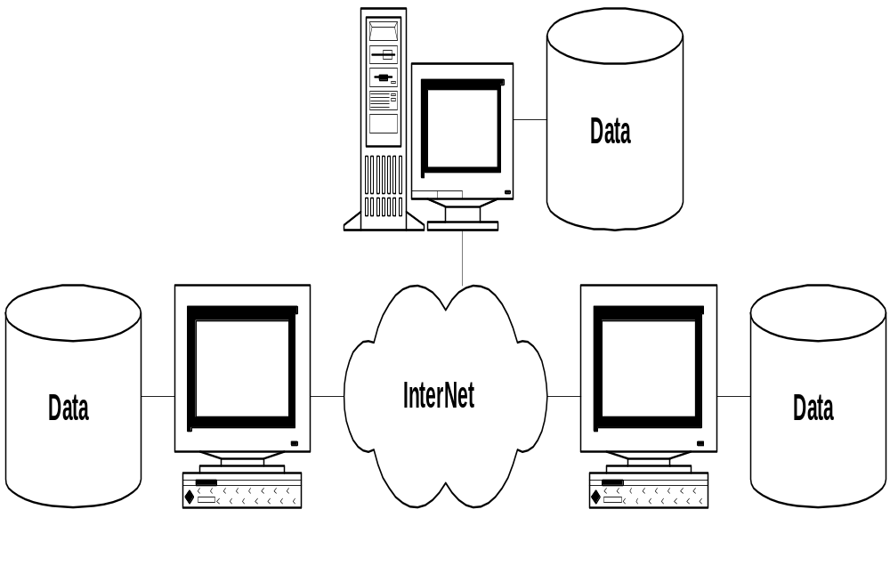
Electronic Data Interchange

Slide 82
Electronic Data Interchange

Slide 83
Electronic Data Interchange
X.21
UN/EDIFACT

Slide 84
Electronic Data Interchange

Slide 85
Electronic Data Interchange

Slide 86
Electronic Data Interchange

Slide 87
Electronic Data Interchange

Slide 88
Electronic Data Interchange

Slide 89
Electronic Data Interchange

Slide 90
Electronic Data Interchange

Slide 91
Example of EDI Message
ST*850*00001
BEG*00*SA*EDI-9966***850816
TAX*5-6777867
N1*ST*THE CORNER STORE*09*0799332120001
N3*601 FIRST STREET
N4*CROSSROADS*NY*10016
N3*900 EASY STREET
PER*PD*JOHN JONES**TE*415-744-8666
ITD*01*03*2.000***10**30
FOB*CC*****OR
DTM*002*851018
PO1*1*16000.00*LB*1.25000*QT*PN*100020167557
CTT*2*36000.00
SE*22*00001

Slide 92
Example of EDI Message
ST*850*00001
BEG*00*SA*EDI-9966***850816
TAX*5-6777867
N1*ST*THE CORNER STORE*09*0799332120001
N3*601 FIRST STREET
N4*CROSSROADS*NY*10016
N3*900 EASY STREET
PER*PD*JOHN JONES**TE*415-744-8666
ITD*01*03*2.000***10**30
FOB*CC*****OR
DTM*002*851018
PO1*1*16000.00*LB*1.25000*QT*PN*100020167557
CTT*2*36000.00
SE*22*00001
ASCII Text Message
Easy To Transport via E-mail
Easy to Transport via Internet
Easy to Protect, say
using PGP, PEM etc.

Slide 93
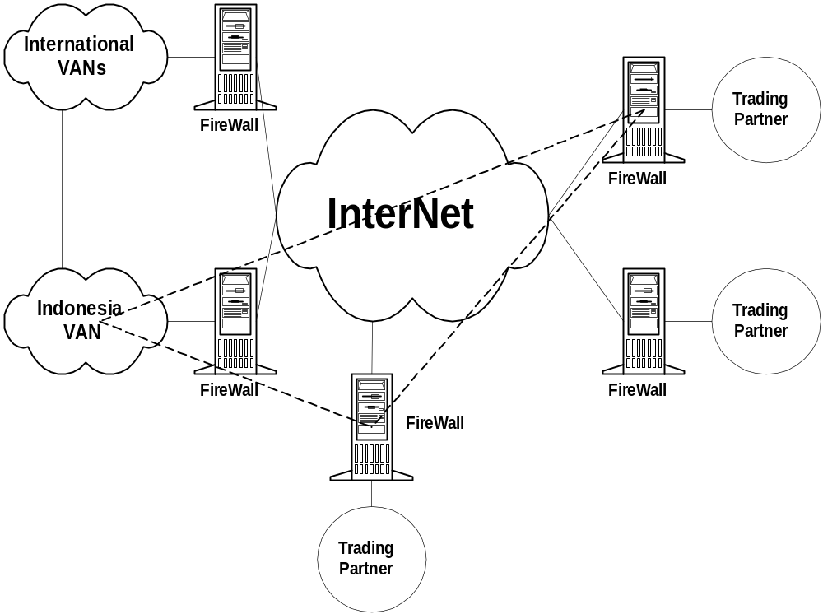

Slide 94
Allow The User to Connect To
VAN & Internet

Slide 95
Firewall To Protect

Slide 96
Tunneling &
Create ExtraNet
(Virtual VAN)

Slide 97
PGP / PEM for
Added Protection

Slide 98
Practical Implementation
W. Houser, J. Griffin & C. Hage, “Request for Comments: 1865: EDI Meets the Internet - Frequently Asked Questions about Electronic Data Interchange (EDI) on the Internet”, January 1996.

Slide 99
Solusi e-Dagang sederhana
Cukup menggunakan e-mail
Bisa menggunakan WARNET!
Mailing list / e-mail
  wong-cilik@isnet.itb.ac.id

Slide 100
Solusi e-Dagang
Transaksi = komunikasi
E-mail → effisiensi
Kita membutuhkan kemampuan kompetisi
Competitiveness → Pengetahuan

Slide 101
Kemampuan Kompetitif ..

Slide 102
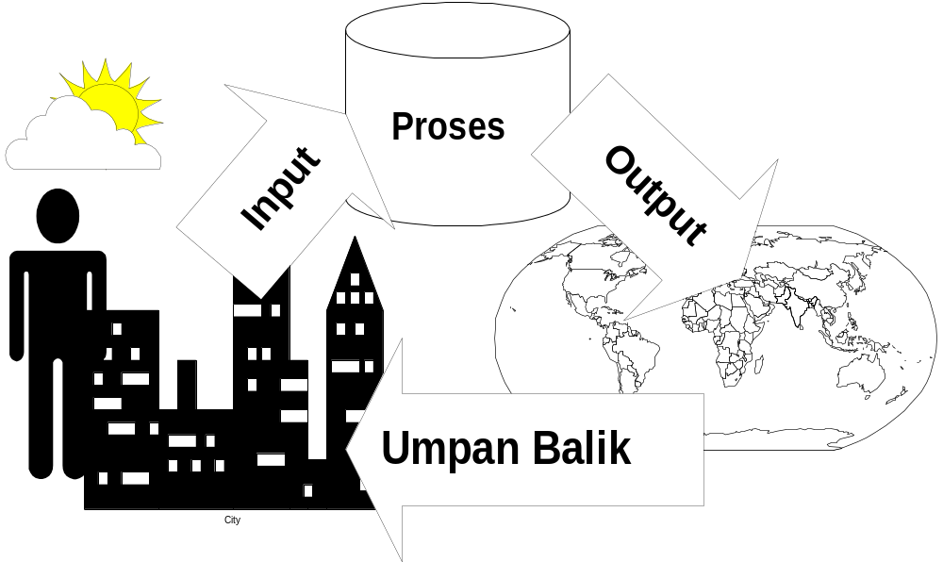
Mencari Model Sederhana ..

Slide 103
Kesimpulan Sementara
Rakyat Lambat.
Media Lambat … cocok bagi rakyat banyak?
Media Perantara
Tidak Berarti Internally Slow.
Kesempatan
  Interface Dunia Lambat
  Massa Lihat / Dengar / Baca.
  Segmentasi Pasar

Slide 104
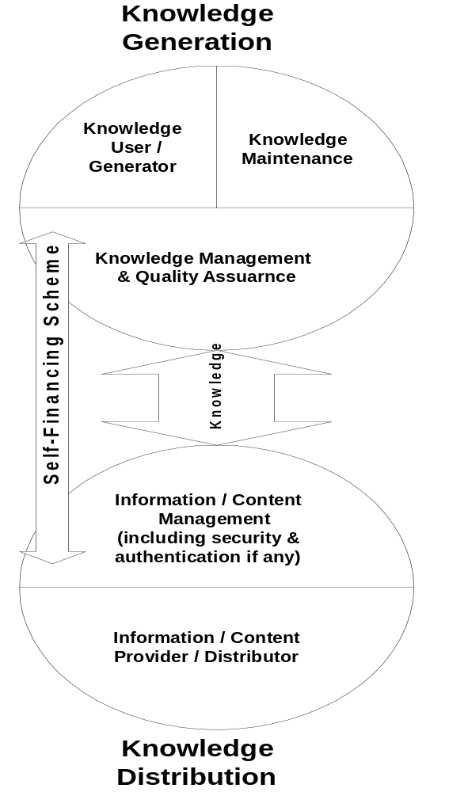
Model N21
http://n21.ac-id.net
http://www.ylti.or.id

Slide 105
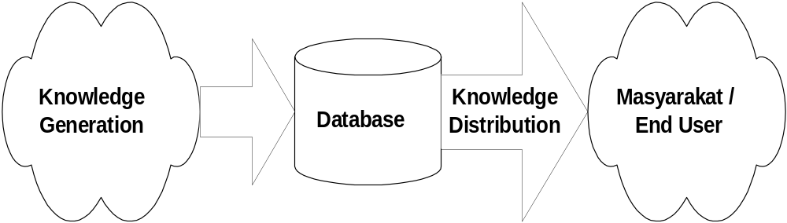
Model Sederhana

Slide 106
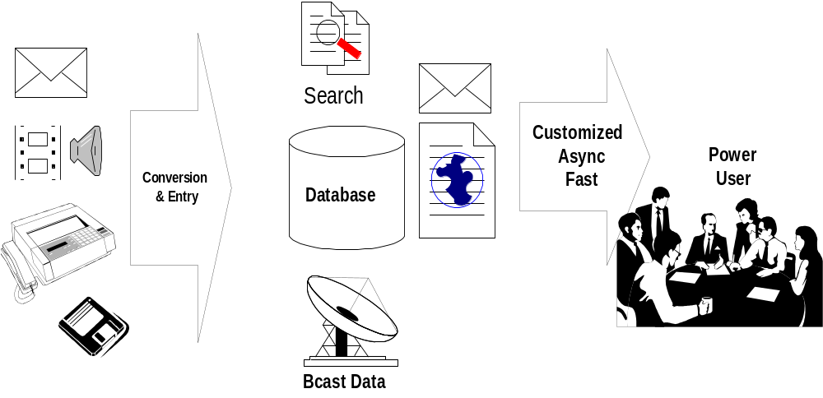
Kondisi Ideal

Slide 107
Isu Penting Kondisi Ideal
Input
  Create Knowledge
Input
  Multimedia
  Multisource

Slide 108
Isu Kondisi Ideal
Proses
  Centrallized / distributed
  Standarisasi database
  Search capability
  Content Rating (ICRA)

Slide 109
Isu Kondisi Ideal
Output
  Customized
  Asynchronous
  Cepat
  Push Technology
  E-mail?

Slide 110
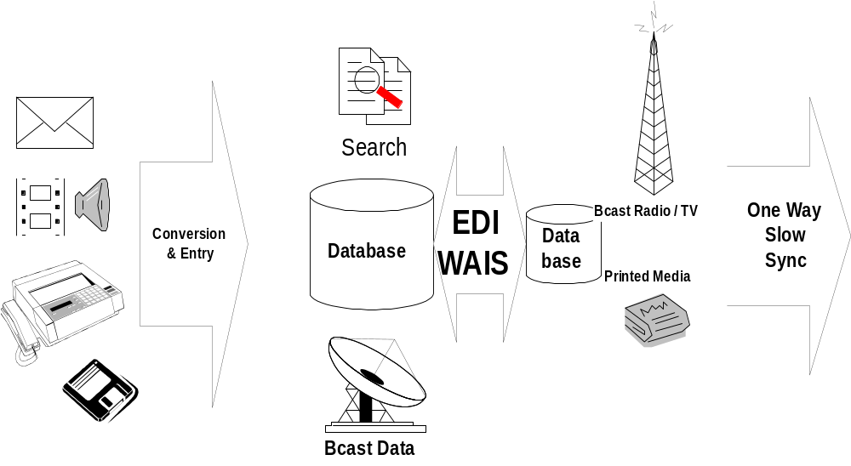
Kondisi Nyata
Perantara ke Masyarakat
Media Massa / LSM

Slide 111
Isu Kondisi Nyata
Output
  Bisnis – to – Bisnis
  Database – to – database
  Broadcast isi database.

Slide 112
Isu Kondisi Nyata
Input
  Lembaga Penelitian / Pendidikan
  Pakar
  Wartawan
  Media Massa

Slide 113
Support Technology Knowledge Management

Slide 114
Enabling Knowledge Management
Browser, Mailbox
UI
Publish, Push, Broadcast
Distribution
Search/Retrieve, Agent, Information Mining, Filters, Collaboration
Processing/Intelligence
Messaging, Middleware, Workflow, WWW/Internet, GroupWare,
Transport
Document Repository, DBMS, Data Warehouse, Legacy, Internet, Extranet
Data

Slide 115





File Load In
Spreadsheets
File servers
Applications
(Java, CORBA,
PL/SQL)
Word processing
documents
Windows clients
Presentations
Drivers
Web browsers
Video
Audio
UNIX
FTP
FTP clients
E-mail
E-mail clients
Voice mail

Slide 116
Digital Library

Slide 117
Layanan Digital Library
Layanan Katalog: database katalog...
Layanan Informasi: search engine...
Layanan Pendidikan: self learning...
Layanan Komunikasi: email, fax...
Layanan Transaksi: interlibrary loan...

Slide 118
Features of Digital Library
Antarmuka pemakai, menggunakan Web Browser.
Katalog dan Abstrak online.
Search engine dan download full teks.
Distance Learning.
Multimedia.
Networking dengan perpustakaan lain.

Slide 119








Sistem Digital Library
CDS/
ISIS
Catalog
Abstract
Teks
Audio
Video
Metadata
Full text &
resources
Team Pustakawan
CD-ROM
Koleksi
INTERNET/
INTRANET
Institusi (Intern)
Digital Library
Inter Library
Network
Digital Library
server
Layanan:
Katalog; searching...
Informasi; searching...
Pendidikan; self learning, editing...
Communication; email, bulletin...
Transaksi; pemesanan, peminjaman...
Koleksi
Transaksi
Anggota
Pemakaian
Database
Administrasi
Pemakai

Slide 120
Elemen Digital Library
Data; koleksi fisik perpustakaan seperti buku, jurnal, majalah, kaset, dll.
Metadata; informasi mengenai koleksi perpustakaan.
Proses; proses yang dilakukan terhadap data dan metadata tersebut.

Slide 121








Elemen Proses
Non
CDS/ISIS
Txt,xls,dbf,...
OPERATOR
Entri
Data
Konversi
ke CDS/ISIS
Katalog
Abstrak
Entri
CDS/ISIS
Upload
(FTP binary)
Metadata
WAIS-ISIS
Repository
Full resources:
Teks
Audio
Video
INTERNET/
INTRANET
Entri
Repository/
Directory
of digital
data
WAIS-ISIS
search engine
Archives
Web Farming
Milis archiver
spider
Digitalisasi
APACHE + PHP
Web server
SWISH-E
indexer &
search engine
OPERATOR
DIGITAL LIBRARY
SERVER

Slide 122



Topologi Minimal DLib
Elemen Proses
PC 200 Mhz
64 MB, 9-40 GB
Unix/Linux
Apache+PHP
WAIS/ISIS
SWISH-E
MySQL
Real Server
PC 166 Mhz
32MB, 1 GB
INTERNET/
INTRANET
DLib Server
Router ke Internet
Ethernet - LAN Backbone/Hub
PC 200 Mhz
64 MB, 9-40 GB
Unix/Linux
Apache+PHP
WAIS/ISIS
SWISH-E
MySQL
PC 166 Mhz
32 MB, 2-6 GB
CD-ROM
Win 95
IE/Netscape
Acrobat Reader
Ms Office
Scanner &
converter
apps
PC 200 Mhz MMX
32 MB, 4-6 GB
CD-ROM
SouundBlaster
Video Capture
Win 95
Multimedia Apps
Video player
Scanner
text-image
DLib Server
Mirror (Back-Up)
Operator
Workstation
Multimedia
Workstation
Cassette player

Slide 123
Layanan Katalog Online
Berbasis database CDS/ISIS
Search Engine WAIS-ISIS (free)
Database lain bisa dimasukkan setelah dikonversi ke format CDS/ISIS
Beberapa format database yang bisa dikonversi ke CDS/ISIS: xls,dbf,txt,…
12 Perpustakaan, 40+ database

Slide 124
Sistem WAIS-ISIS
Data
CDS/ISIS
Data
CDS/ISIS
WAIS-ISIS
server
WAIS-ISIS
server
networking
networking
Data
CDS/ISIS
WAIS-ISIS
server
cgi
Apache
Web server
INTERNET/
INTRANET
Dlib Server

Slide 125
Layanan Full Teks
Pemakai dapat menelusuri database resource melalui search engine
Dapat melihat abstrak dan mendownload full teks (resource)
Resource berupa: teks, audio, video, compressed file, binary, ASCII,...
Elemen: data, metadata, indexer & search engine (SWISH-E, free)

Slide 126
Sistem SWISH-E
SWISH-E merupakan software indexer dan search engine yang simple, cepat, dan free.
Masukan: File system dan URL (HTTP).
Cocok untuk digital library yang simple.
Dikombinasikan dengan Apache + PHP (html scripting language) --> dapat diakses dari Web dan powerfull.

Slide 127
Sistem SWISH-E
Data
Files/Data
Repository
URL-URL
Metadata:
- Title
- Author
- Subject
- Abstract,...
Spidered
Full resources:
Teks
Audio
Video
SWISH-E
indexer - Spider
search engine
Indexed
INTERNET/
INTRANET
Apache
Web server

Slide 128
Tools
Server
Web server (apache)
Indexer (Wais/Isis, Harvest, Swish-E, Dienst,Isite)
CGI (YNIS, wwwwais, perl scripts, PHP, dll)
Database (POSTGRESQL, Mysql, Msql, dll)
OS (Unix FreeBSD, Linux)
Mail achiving (hypermail, MhonArc, Procmail)
Client
Web Browser (IE, Netscape)
Adobe Acrobat reader
http://sunsite.berkeley.edu/Tools/
Semua Free, dapat
didownload di Internet

Slide 129
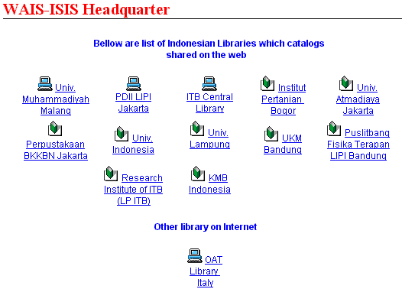
Catalog Map

Slide 130
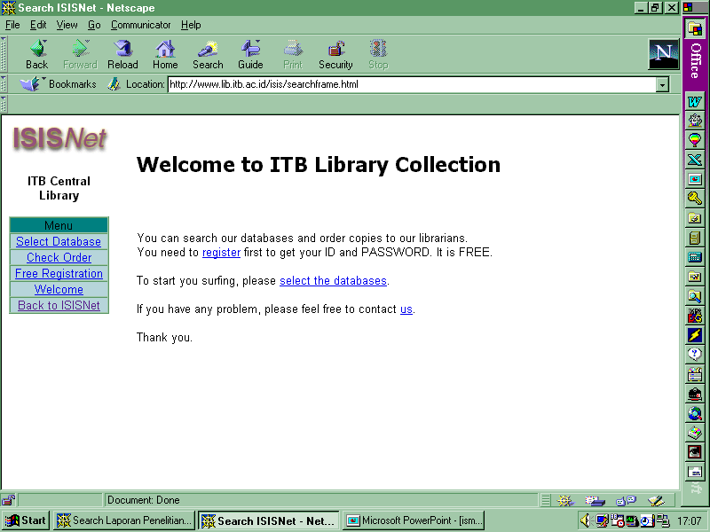

Slide 131
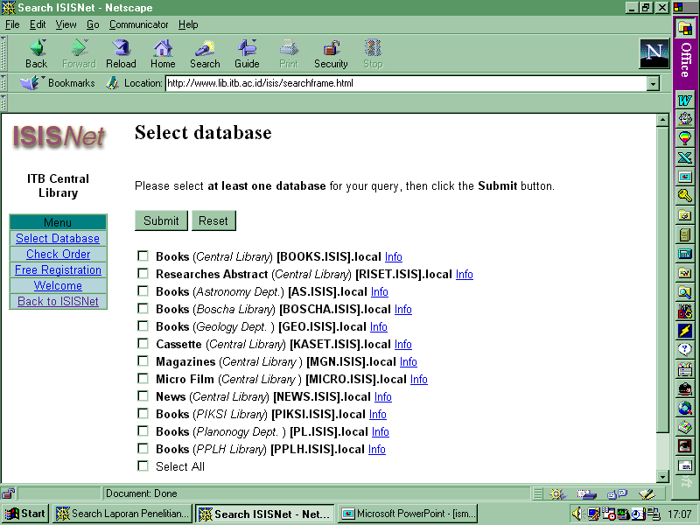

Slide 132
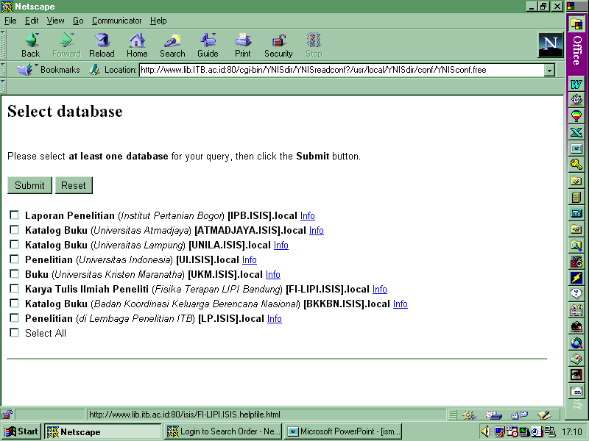

Slide 133
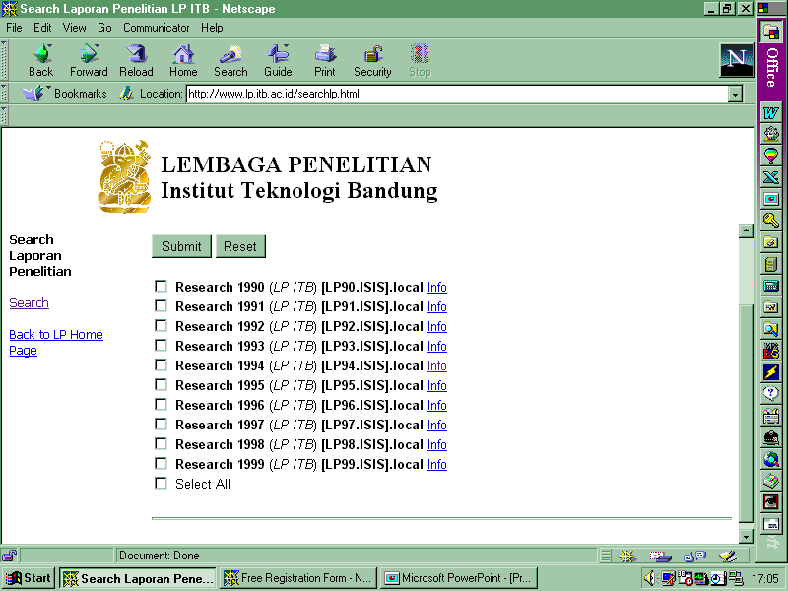

Slide 134
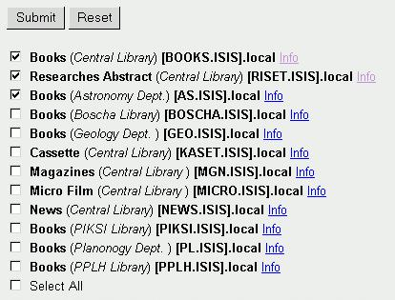
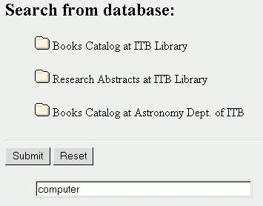
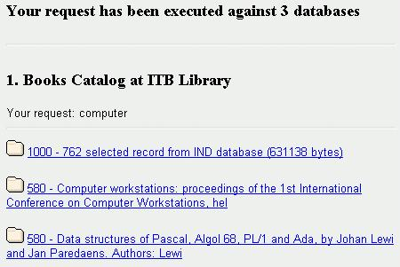
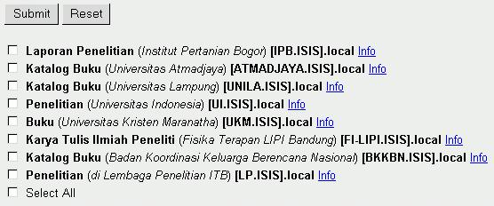

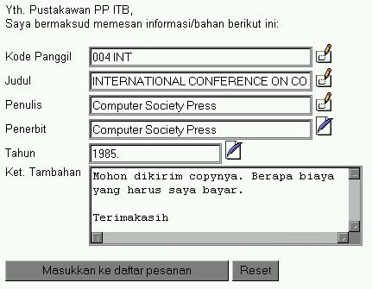
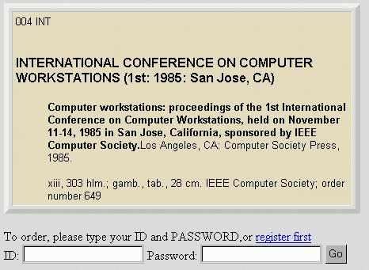
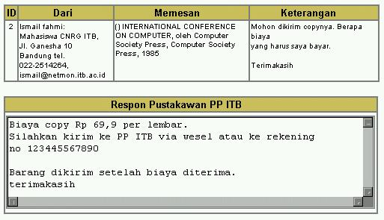
Contoh Catalog Searching
Databases
collection
Select
database
Search
result
Librarian
response
Catalog
view
Ordering

Slide 135

Terima Kasih

